Slide 1
AWT and Swings in java

Slide 2
Introduction
JDK includes an extensive set of classes and methods, assembled in a package called AWT(abstract window toolkit), which is used to create interface for java applications

Slide 3
AWT classes and subclasses
Component: contains sub classes and methods for creating interface components such as labels, checkboxes and text boxes
Container: includes the classes and methods that provide a container object, such as a window or a panel, which hold the interface component

Slide 4
Component
Is the super class, and is at the top of the AWT inheritance hierarchy
All classes within the hierarchy, either directly or indirectly, extends the component class
It defines the common features of a component through a wide range of methods, which can be used for event handling, drawing components and their content, and handling position and size of component

Slide 5
Methods
Dimension getSize()
void setSize(int width, int height)
void setLocation(int x,int y)
void setForeGround(Color c)
void setBackGround(Color c)
void setVisible(boolean b)

Slide 6
Container
Is a subclass of Component class
All components inside the same container are called siblings, since they have the same parent window
Methods:
void add(Component c)
void remove(Component c)
void removeAll()

Slide 7
Contd..
AWT package includes classes that directly or indirectly
extend the container class. These classes are:
Window
Panel
Applet
Frame
Dialog

Slide 8
Window class
It is a commonly used GUI element that is used to display the controls and data within an application
Window class does not include a title, menus, or border
Methods:
void pack():- used to adjust layout of a window
void show():- used to display window on screen
void dispose():- used to free the memory allocated to
window
Generally, you won’t create Window objects directly. Instead, you will use a subclass of Window called Frame

Slide 9
Frame class
An object of the Frame class, called a frame is a window with a title and resizing buttons, that is minimize, maximize and close. A frame can also contain a menu bar at the top
Frame()
Frame(String title)
Frame frm=new Frame()
frm.show()

Slide 10
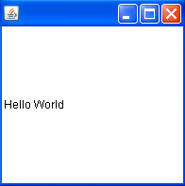
import java.awt.*;
public class frame extends Frame
{
public static void main(String args[])
{
new frame();
}
frame()
{
Label lb= new Label("Hello World");
add(lb);
this.setSize(100, 100);
setVisible(true);
}
}

Slide 11
Dialog class
It is a subclass of window class
It differs from a frame in that it does not have a menu bar or an icon, and it cannot be resized
These are pop-up windows that you can use to accept input from the user
Dialogs are always dependent on other windows. As a result, a dialog box is always created from existing window
There are 2 types of dialog boxes:
Modal
Modeless

Slide 12
Modal dialog boxes, which require the user to respond before continuing the program
Modeless dialog boxes, which stay on the screen and are available for use at any time but permit other user activities

Slide 13
Creating a Dialog box
Dialog(Frame owner_frame)
Dialog(Frame owner_frame, String title)
Dialog(Frame owner_frame, String title, boolean modal)
For eg:
Dialog dg1=new Dialog(frame1, “hhiii”, true);

Slide 14
Panel class
The Panel class is a concrete subclass of Container. It doesn’t add any new methods; it simply implements Container
Panel is the superclass for Applet. When screen output is directed to an applet, it is drawn on the surface of a Panel object
Panel does not contain a title bar, menu bar or border, and it cannot be a top-level window
Panel p1=new Panel();
frame1.add(p1);

Slide 15
Applet class
Applet class extends the Panel class
An applet is also a container, the difference from other containers is that it can be deployed in a web browser
It is a special container that can be transmitted over internet
An applet can be viewed in a java enabled web browser

Slide 16
Controls in AWT
Controls Classes
Textbox TextField
Textarea TextArea
Label Label
Checkbox CheckBox
Radiobutton CheckboxGroup
CheckBox
Combobox Choice
Listbox List
Button Button

Slide 17
Swings

Slide 18
Swing is a rich user interface toolkit
containing various components such as lists,
trees and tables

Slide 19
AWT vs. Swings
The AWT defines a basic set of controls, windows, and dialog boxes that support a usable, but limited graphical interface.
One reason for the limited nature of the AWT is that it translates its various visual components into their corresponding, platform-specific equivalents, or peers.
This means that the look and feel of a component is defined by the platform, not by Java.
Because the AWT components use native code resources, they are referred to as heavyweight.

Slide 20
Two Key Swing Features
Swing Components Are Lightweight
Swing components are lightweight. This means that they are written
entirely in Java and do not map directly to platform-specific peers

Slide 21
Swing Supports a Pluggable Look and Feel
Swing supports a pluggable look and feel (PLAF). Because each Swing
component is rendered by Java code rather than by native peers, the look
and feel of a component is under the control of Swing, not of the underlying
operating system.
This means that each component will work in a consistent manner across all
platforms.

Slide 22
Swing equivalents of AWT components
JLabel
- New Features: HTML content images, borders
JButton
- New Features: icons, alignment
JPanel
- New Features: borders
JSlider
- New Features: tick marks and label

Slide 23
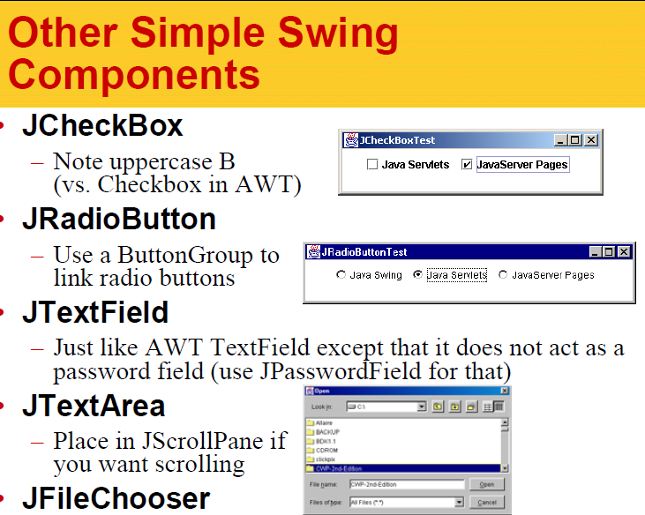

Slide 24
JLabel
JLabel defines several constructors. Here are three of them:
JLabel(Icon i)
JLabel(String s)
JLabel(String s, Icon i, int align)
ImageIcon ii = new ImageIcon("france.gif");
JLabel jl = new JLabel("France", ii, JLabel.CENTER);

Slide 25
JTextField
Three of JTextField’s constructors are shown here:
JTextField(int cols)
JTextField(String str, int cols)
JTextField(String str)

Slide 26
The Swing Buttons
Swing defines four types of buttons:
JButton,
JToggleButton,
JCheckBox, and
JRadioButton.
All are subclasses of the AbstractButton class, which extends JComponent.

Slide 27
JButton
The JButton class provides the functionality of a push button. JButton allows an icon, a string, or both to be associated with the push button. Three of its constructors are shown here:
JButton(Icon icon)
JButton(String str)
JButton(String str, Icon icon)

Slide 28
JToggleButton
A useful variation on the push button is called a toggle button.
A toggle button looks just like a push button, but it acts differently because it has two states: pushed and released. That is, when you press a toggle button, it stays pressed rather than popping back up as a regular push button does. When you press the toggle button a second time, it releases (pops up). Therefore, each time a toggle button is pushed, it toggles between its two states.
JToggleButton(String str)

Slide 29
Check Boxes
The JCheckBox class provides the functionality of a check box. Its immediate superclass is JToggleButton, which provides support for two-state buttons. JCheckBox defines several constructors. The one used here is
JCheckBox(String str)

Slide 30
Radio Buttons
Radio buttons are a group of mutually exclusive buttons, in which only one button can be selected at any one time. JRadioButton provides several constructors.
The one used in the example is shown here:
JRadioButton(String str)
Example:
JRadioButton b1 = new JRadioButton("A");

Slide 31
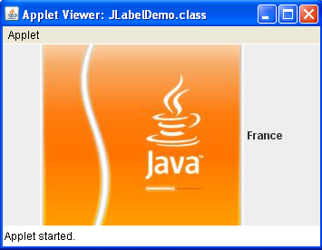
import java.awt.*;
import javax.swing.*;
/*<applet code="JLabelDemo" width=250 height=150>
</applet>*/
public class JLabelDemo extends JApplet
{
public void init()
{
// Get content pane
Container c = getContentPane();
// Create an icon
ImageIcon ii = new ImageIcon("c:\\image1.jpg");
// Create a label
JLabel jl = new JLabel("France", ii, JLabel.CENTER);
// Add label to the content pane
c.add(jl);
}
}

Slide 32
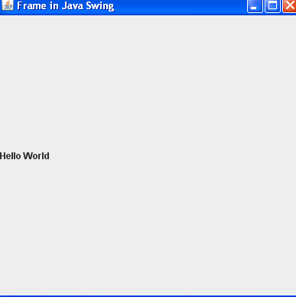
public class frame extends JFrame
{
Container c=getContentPane();
public static void main(String args[])
{
new frame();
}
frame()
{
JLabel lb= new JLabel("Hello World");
c.add(lb);
this.setSize(400, 400);
this.setVisible(true);
}
}

Slide 33
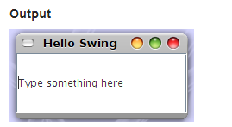
Example
import javax.swing.JFrame;
import javax.swing.JLabel;
import javax.swing.JTextField;
public class LabelnText
{
public static void main(String[] args)
{
JFrame frame = new JFrame("Hello Swing");
frame.setSize(200, 100); frame.setDefaultCloseOperation(JFrame.EXIT_ON_CLOSE); frame.add(new JLabel("Diving into swing!"));
frame.add(new JTextField("Type something here")); frame.setVisible(true);
}
}

